Slide 1
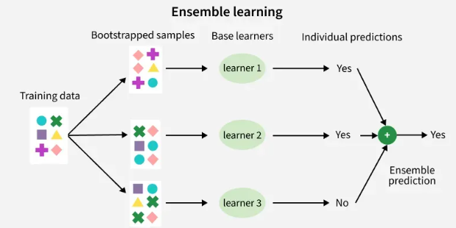
Ensemble Learning
Ensemble Learning is a machine learning technique in which multiple models (called weak learners) are trained and combined to make a single, stronger model that achieves better accuracy, stability, and generalization than any individual model.
Key idea: “Many models together perform better than one.”
Why it works:
Reduces variance (e.g., bagging)
Reduces bias (e.g., boosting)
Improves overall prediction robustness

Slide 2
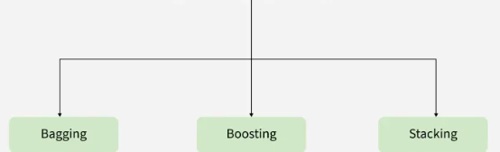
Types
Bagging (e.g., Random Forest): trains models independently and averages results
Boosting (e.g., AdaBoost, Gradient Boosting, XG Boost): trains models sequentially, focusing on errors
Stacking: combines different models using a meta-model

Slide 3
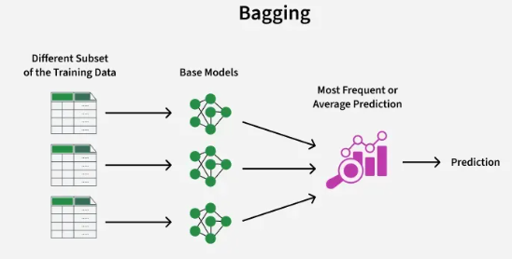
Bagging (Bootstrapped sampling)
Bagging (Bootstrap Aggregating) is an ensemble learning technique used to reduce variance and improve model stability by training multiple models on different random samples of the same dataset and combining their predictions.
Key Points:
Uses bootstrap sampling (sampling with replacement)
Models are trained independently and in parallel
Final prediction is made by:
Averaging (for regression)
Majority voting (for classification)
Works best with high-variance models (e.g., Decision Trees)
Steps in Bagging:
Create multiple bootstrap samples from the training data
Train a base model on each sample
Combine predictions from all models
Advantages:
Reduces overfitting
Improves accuracy and robustness
Easy to parallelize
Limitation: Does not reduce bias , Less effective for low-variance models

Slide 4
Random Forest
Random Forest is an ensemble learning algorithm that uses Bagging (Bootstrap Aggregating) with decision trees as base learners and adds feature randomness to further improve performance.
How Random Forest uses Bagging
Bootstrap Sampling:
Multiple datasets are created by sampling with replacement from the original data.
Train Decision Trees:
Each bootstrap sample trains a separate decision tree.
Feature Randomness (extra step beyond bagging):
At each split, a random subset of features is considered.
Aggregation:
Classification → Majority voting
Regression → Average prediction
Why Random Forest is better than plain Bagging
Reduces correlation between trees
Lowers variance more effectively
Handles overfitting better than a single tree
Key Characteristics
Parallel training of trees
Works well with high-dimensional data
Robust to noise and outliers
Built-in feature importance

Slide 5
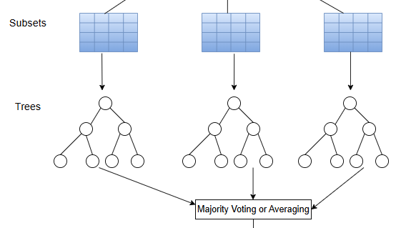
Extremely Randomized Trees (Extra Trees)
Ensemble learning method using multiple decision trees
Adds maximum randomness to reduce variance
Working
Uses full training data (no bootstrapping by default)
Randomly selects feature subsets
Chooses random split points (not optimal splits)
Final output = average (regression) / majority vote (classification)
Advantages
Faster training than Random Forest
Lower overfitting, robust to noise
Handles high-dimensional data well
Limitations
Slightly higher bias
Less interpretable
Needs many trees for stability

Slide 6
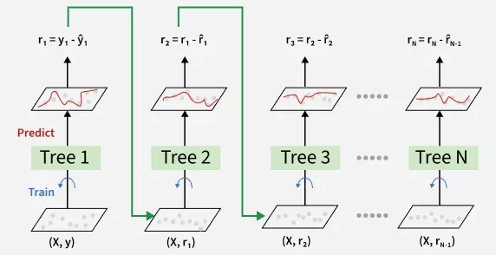
Gradient Boosting
Ensemble learning technique that builds models sequentially
Combines weak learners (decision trees) to form a strong model
Key Idea
Each new model corrects the errors of the previous model
Optimization done using gradient descent on a loss function
Working
Start with an initial prediction
Compute residuals (errors)
Train next tree on residuals
Add predictions using a learning rate
Final prediction = weighted sum of all trees
Advantages
High predictive accuracy
Works with different loss functions

